Slide 1



B-tech Project Portal For IT Department
Members:
Atharva Kitkaru (1814033, TY, IT)
Nishavak Naik (1814040, TY, IT)
Jill Shah (1814055, TY, IT)
Mentor:
- Anooja Joy

Slide 2
Authentication
The portal has three types of users namely:
Student
Guide
Coordinator
Login page is common for all.
Students have sign up page.
First Coordinator is responsible for creating other guide and coordinators.

Slide 3
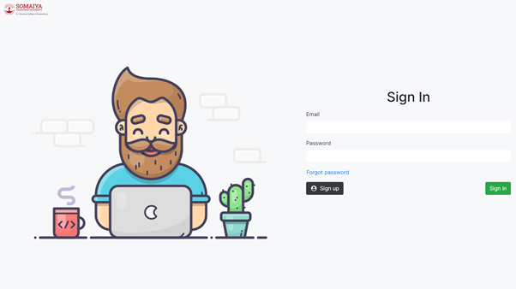
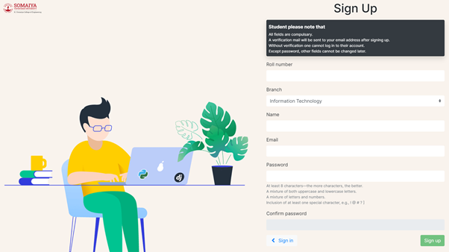
Authentication
Login page
Student Signup

Slide 4
Student
Students have to be a part of some group before proceeding to the dashboard.
Either student can create his/her own group or join some other group by asking other team’s leader to add them.
The student assigned as the team leader would be responsible for:
Addition of other members.
Transferring leadership to another member.
Removal of a member.
Sending requests to guide.
Providing project information.
Making assignment submissions.

Slide 5
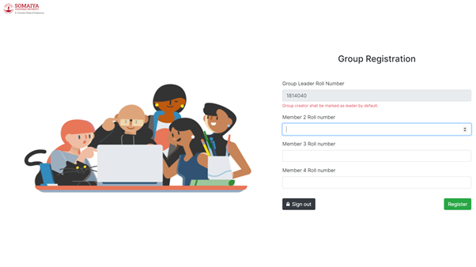
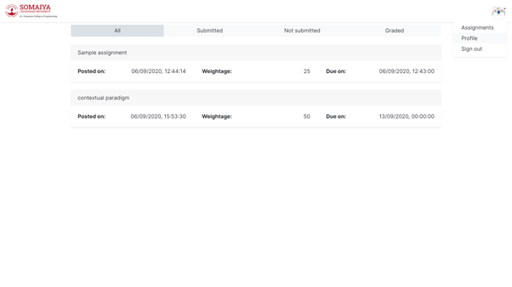
Student
Group registration page
Student Dashboard

Slide 6
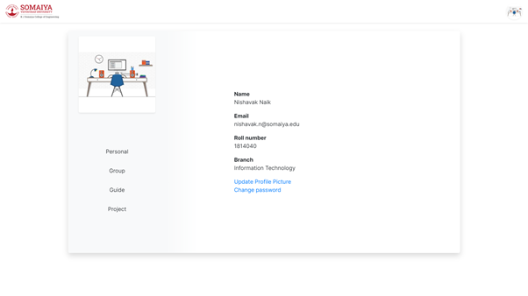
Student
Student profile page

Slide 7
Coordinator
Coordinator’s can:
View and download
Student List
Group List
Guide List
Project List
Submission statistics
Grading statistics
View
Student details
Group details
Project details
Assignment list
Team submission list
Team’s grades
Create
Assignments (Create, Edit and Delete)
Guides
Coordinators
Handle
Group requests
Change of leader
Removal of student from a group
Project requests
Project approval

Slide 8
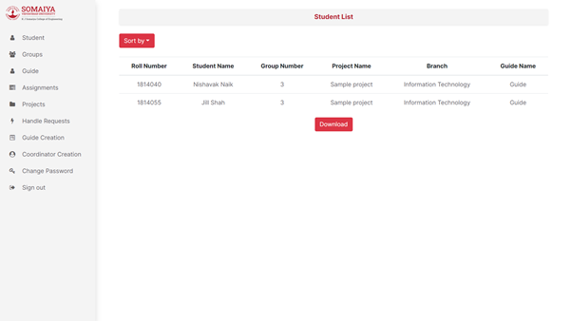
Coordinator
Coordinator Dashboard

Slide 9
Guide
Guides:
Can be assigned to maximum of two groups.
Team requests page is provided for convenience of selection of team by the guide.
Grade only the teams the guide is assigned to.
Can have a look at group’s project details and team details.
Provide their preferences namely:
Area of interests
Thrust areas

Slide 10
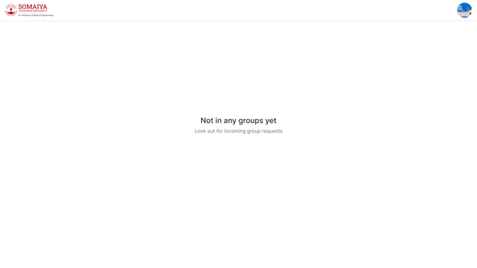
Guide
Guide Dashboard

